Slide 1
Program
Explain

Slide 2
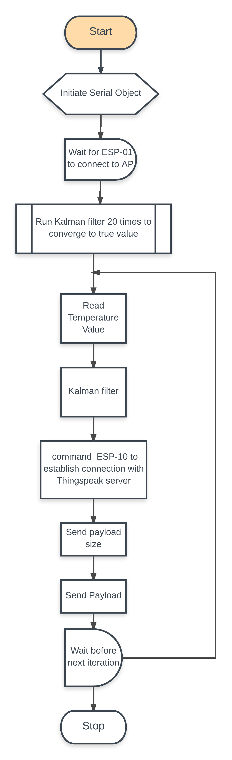
Flow Chart

Slide 3
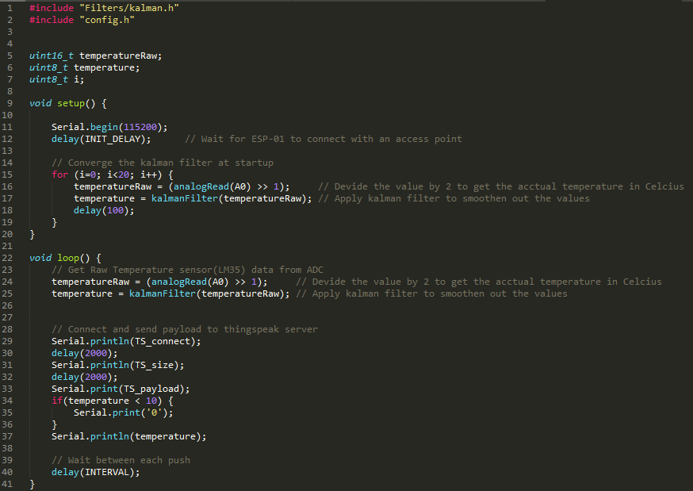
Code

Slide 4
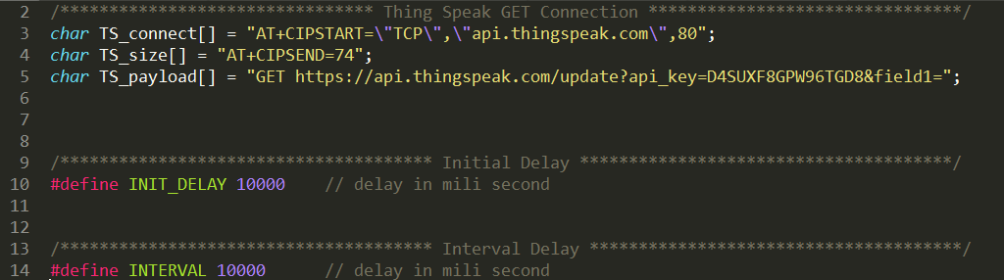
config.h
Establish Connection with Thingspeak Server
Declare Payload size (i.e. 74 bytes)
Payload without the temp. value
Chanel Key

